Slide 1


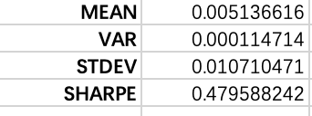
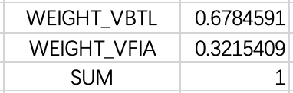
Preparations: Get Optimal Weights for the Portfolio
Prepare average returns for VBTL and VFIA and covariance matrix between them from Jan 12 to Dec 15;
Set random weights to both stocks and calculate the expected return, standard deviation and Sharpe Ratio for portfolio;
Use Solver to maximize Sharpe Ratio by modifying weights to both stocks, given that the sum of weight remaining as one
Get the optimal weight: 67.8% for VBTL and 32.2% for VFIA

Slide 2
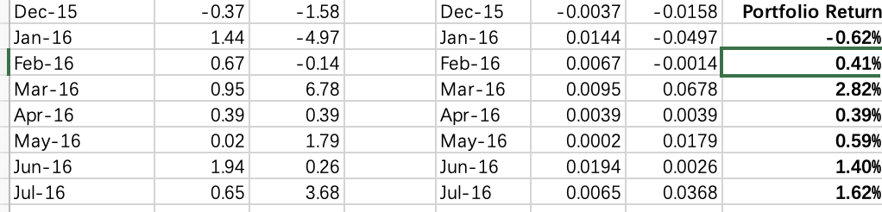
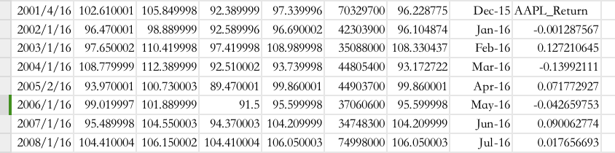
Get the performance (expected return) for both portfolio and AAPL in 2016 for testing:
Portfolio: Weight_1*Return_1+Weight_2*Return_2
AAPL: Just as before!
This month’s return / last month’s return -1

Slide 3
Compare the performance:
AAPL does possess the highest return at about 12.5%; however, its lowest return is nearly -15%, while the lowest return for the portfolio is super mild, a little lower than -0.5%.
Conclusion: Single AAPL is a much more volatile strategy than the Portfolio.

Slide 4
Let’s check the relationship between VBTA and VFIA:
In 2016, they seem to have no apparent correlation

Slide 5
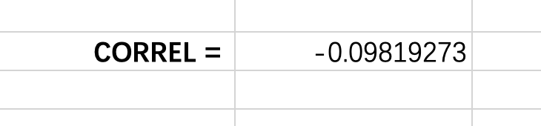
In 2016, the scatter plot of the two stocks performs a negative correlation, and the correlation is indeed negative (-0.098). In this way, the portfolio follows the rule of diversification, where the component stocks don’t change in the same direction in return.
Instead, while VBTA generates a negative return, VFIA has the tendency to move oppositely to compensate the risk in general, and vice versa. The less volatile performance in portfolio than single AAPL also demonstrates the effectiveness of diversification to reduce risks when investing money.

